Slide 1


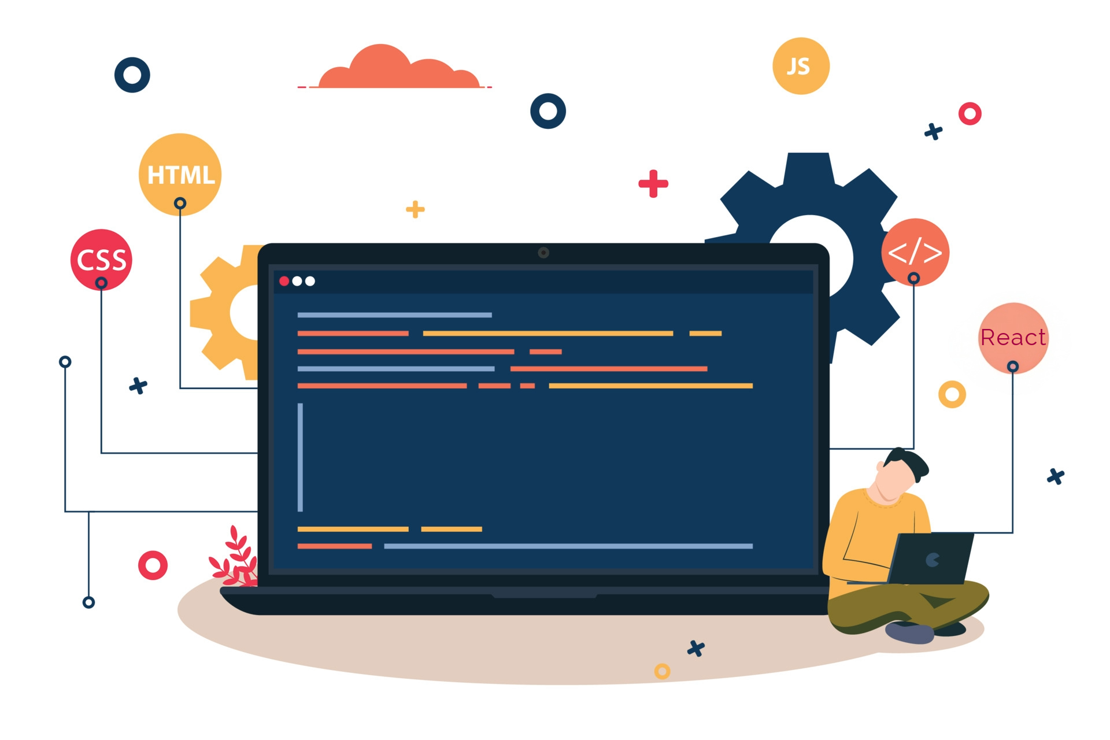



Lecture 32:
React Router Basics
Course - Web Development - II
-By
Instructor Name
welcome@krmangalam.edu.in
Sohna Road,Gurugram,Haryana 122103

Slide 2

| Table of Contents
Setting up React Router.
Creating Multiple Pages (Routes).
Link & NavLink Components.
References.
The End.

Slide 3

|
So far, we’ve built apps on a single page. But what if our client asks for Home, About, and Contact — should we build three separate apps?

Slide 4
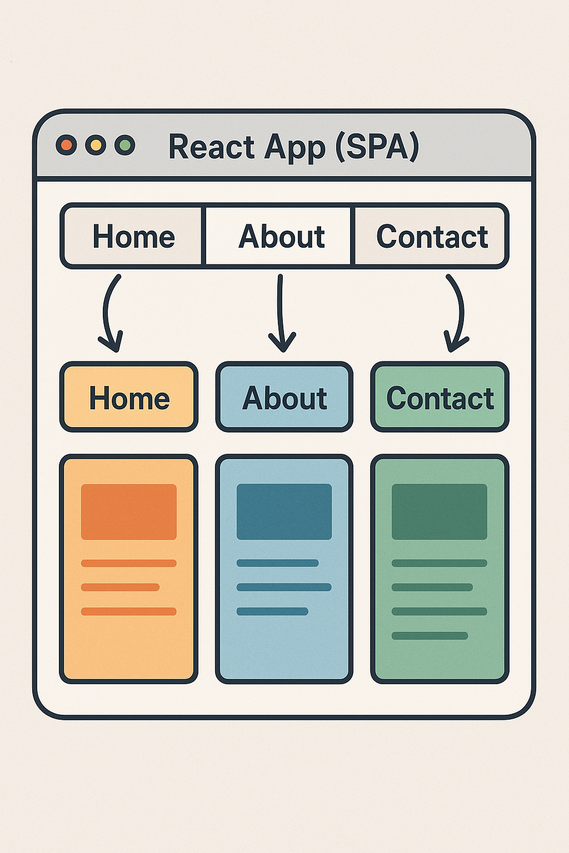
|
So far, we’ve built apps on a single page. But what if our client asks for Home, About, and Contact — should we build three separate apps?
No, we don’t need to build three separate apps. React is a Single-Page Application (SPA) framework, which means everything still lives in one page.
Instead of making separate apps, we can use a library called React Router to handle navigation.
It lets us define different ‘routes’ like /home, /about, and /contact, and load different components for each, without reloading the whole page.

Slide 5
| React-Router
React Router is a library for routing in React applications.
It allows you to create multiple views (pages) in a Single-Page Application (SPA).
Instead of reloading the entire page, it loads and switches different components based on the URL.

Slide 6
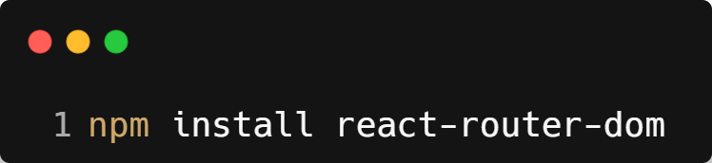
| Setting Up React-Router
Installation of React-Router
Open your terminal inside the React project folder and run:
This installs the React Router library for web app.

Slide 7
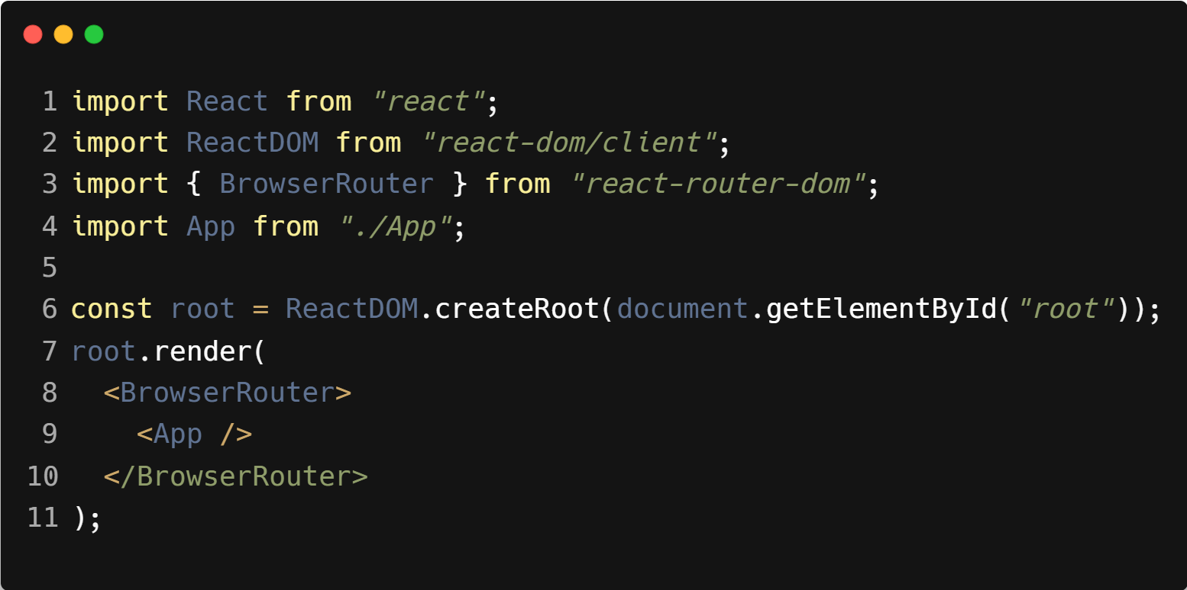
| Setting Up React-Router
2. Import BrowserRouter in main.jsx
Wrap your <App /> with BrowserRouter.

Slide 8
|
Imagine Facebook had only one screen — you’d see your newsfeed but never reach your profile, messages, or settings. How would that feel?

Slide 9

|
Imagine Facebook had only one screen — you’d see your newsfeed but never reach your profile, messages, or settings. How would that feel?
It would feel incomplete and frustrating, right? A real app needs multiple sections or pages. That’s why in React we use Creating Multiple Pages (Routes).
By defining a route for each page — like NewsFeed, Profile, Messages, or Settings — users can smoothly navigate between them inside the same app.

Slide 10
| Routes and Route
<Routes>
Think of it as a container or a switchboard.
It holds all the possible paths (routes) your app can take.
Only one route inside <Routes> will match and render at a time.
<Route>
Defines a single path in your app.
Each <Route> maps a URL path (like /about) to a component (like <About />).
Multiple <Route> components live inside <Routes>.
Together : <Routes> manages all exits, <Route> decides which exact path the user takes.

Slide 11
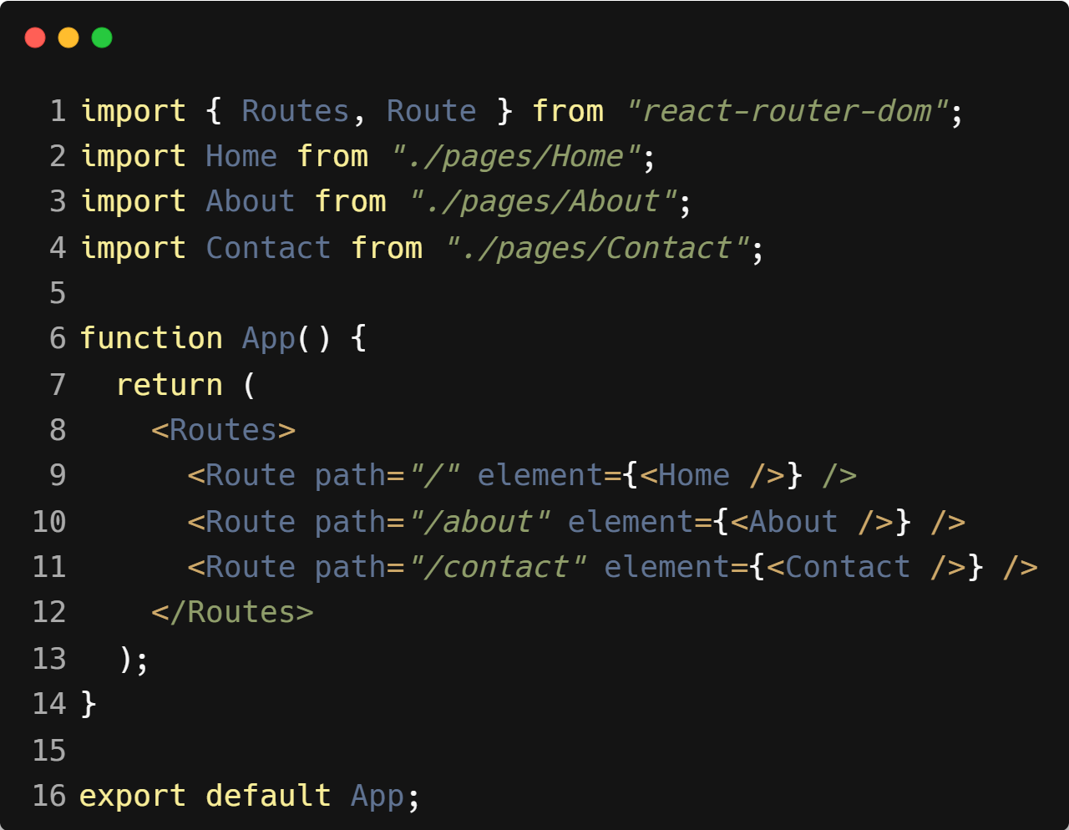
| Example : Routes and Route

Slide 12

|
If React Router gives us multiple pages, how do users actually navigate between them? Do they guess the path, or do we give them clickable links?

Slide 13
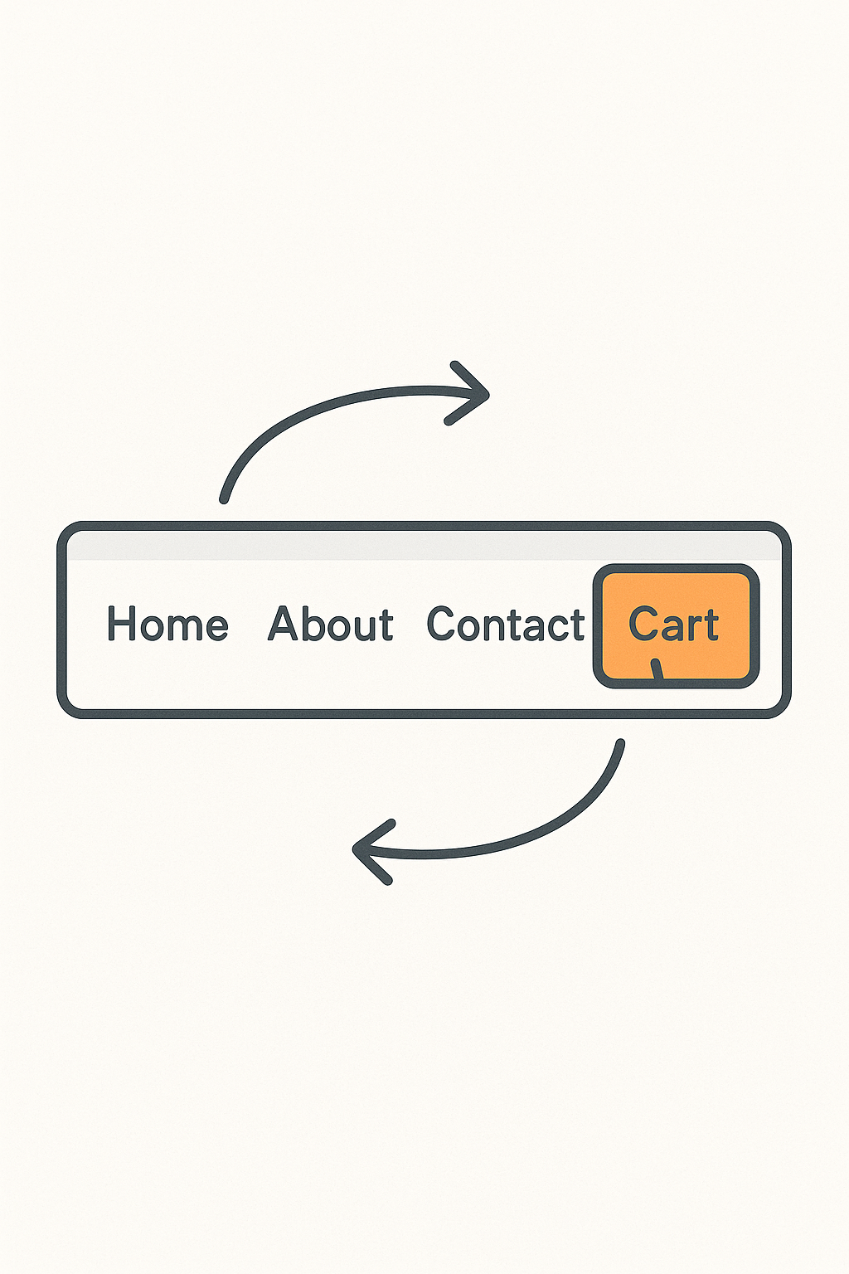
|
If React Router gives us multiple pages, how do users actually navigate between them? Do they guess the path, or do we give them clickable links?
Of course, users don’t guess the path — we give them clickable links to move between pages.
In React Router, we use the Link component instead of the regular <a> tag, because Link lets us navigate smoothly without reloading the page.
And if we want to show which page is currently active (like highlighting the ‘Cart’ tab on Amazon), we use NavLink.

Slide 14
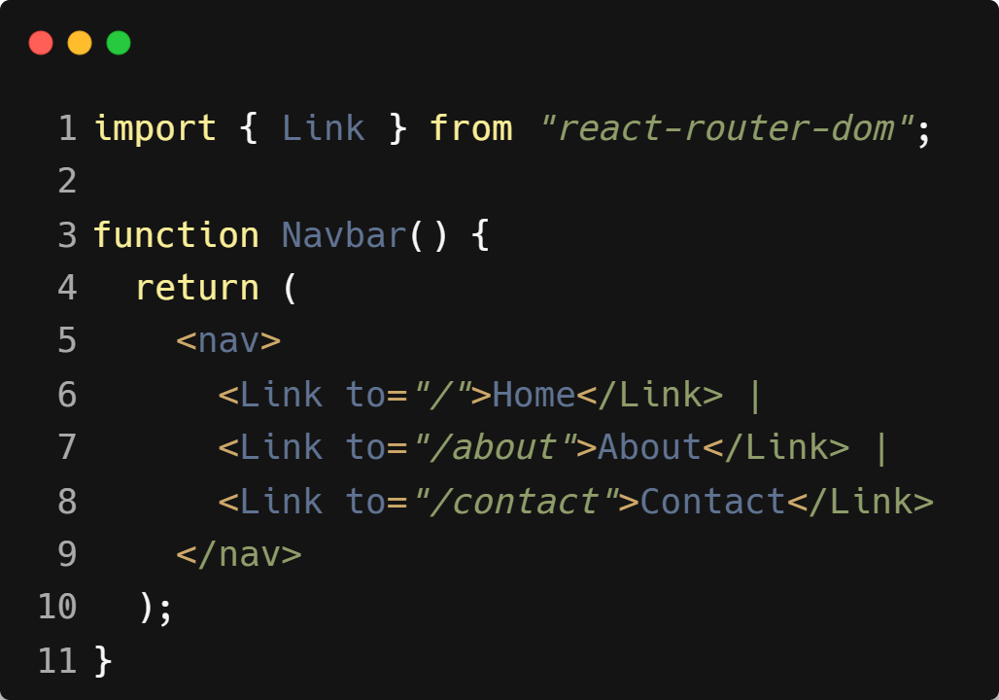
| Link
Used to navigate between pages in a React Router app.
Works like an <a> tag, but does not reload the whole page.
Gives smooth navigation in a Single-Page Application (SPA).
Example :

Slide 15
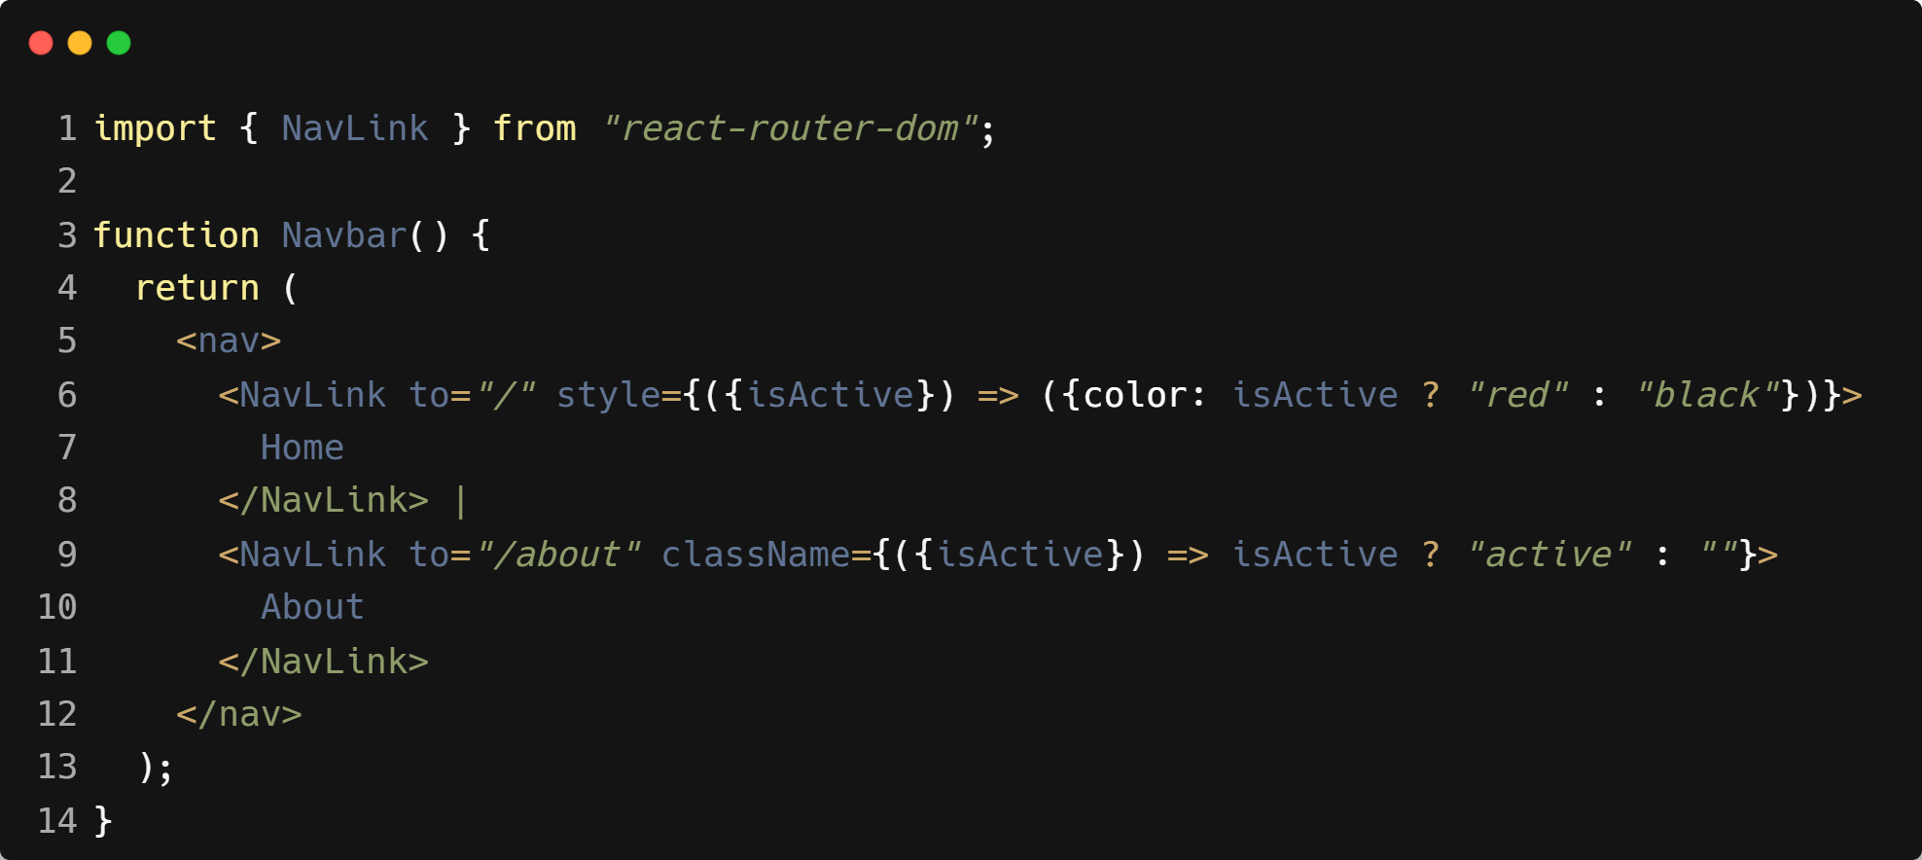
| NavLink
Works like Link but adds styling for the active link.
Automatically applies a class when the route is active.
Useful for highlighting the current page in a navbar.
Example :

Slide 16

| Coding Questions
1. Basic Multi-Page Setup
Task :
Create a simple two-page application.
Set up BrowserRouter in your src/main.jsx file.
Create two simple components: HomePage (renders <h1>Home</h1>) and AboutPage (renders <h1>About</h1>).
In App.jsx, define routes for / and /about.
Add <Link> components to navigate between the two pages.

Slide 17
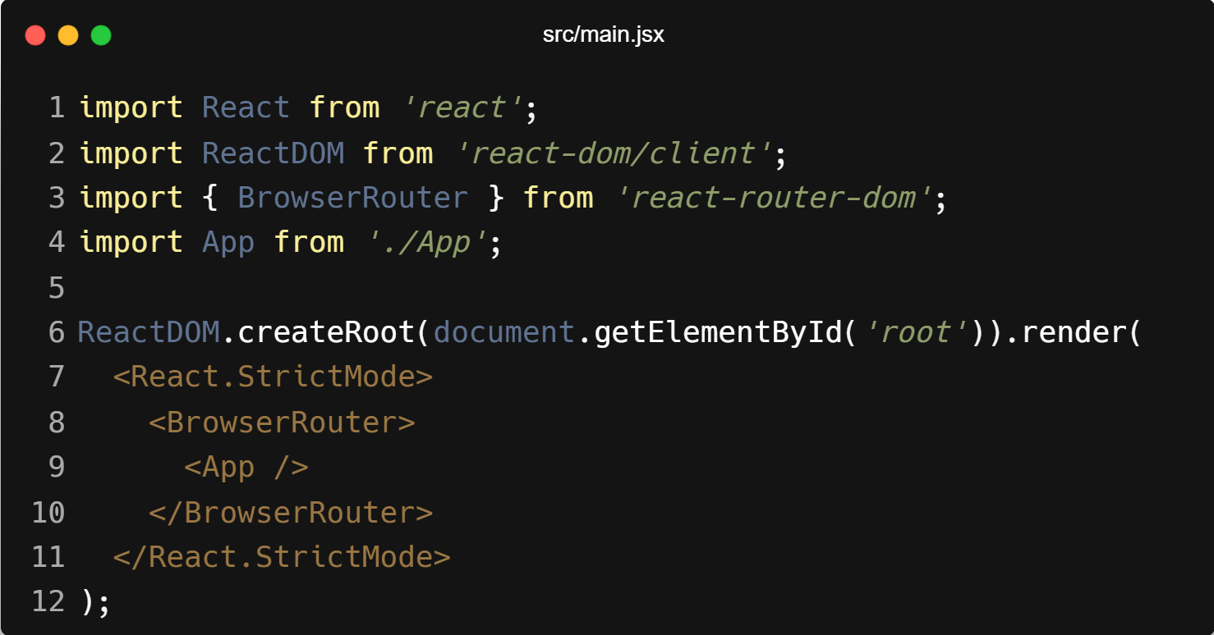
| Coding Questions
Solution :

Slide 18
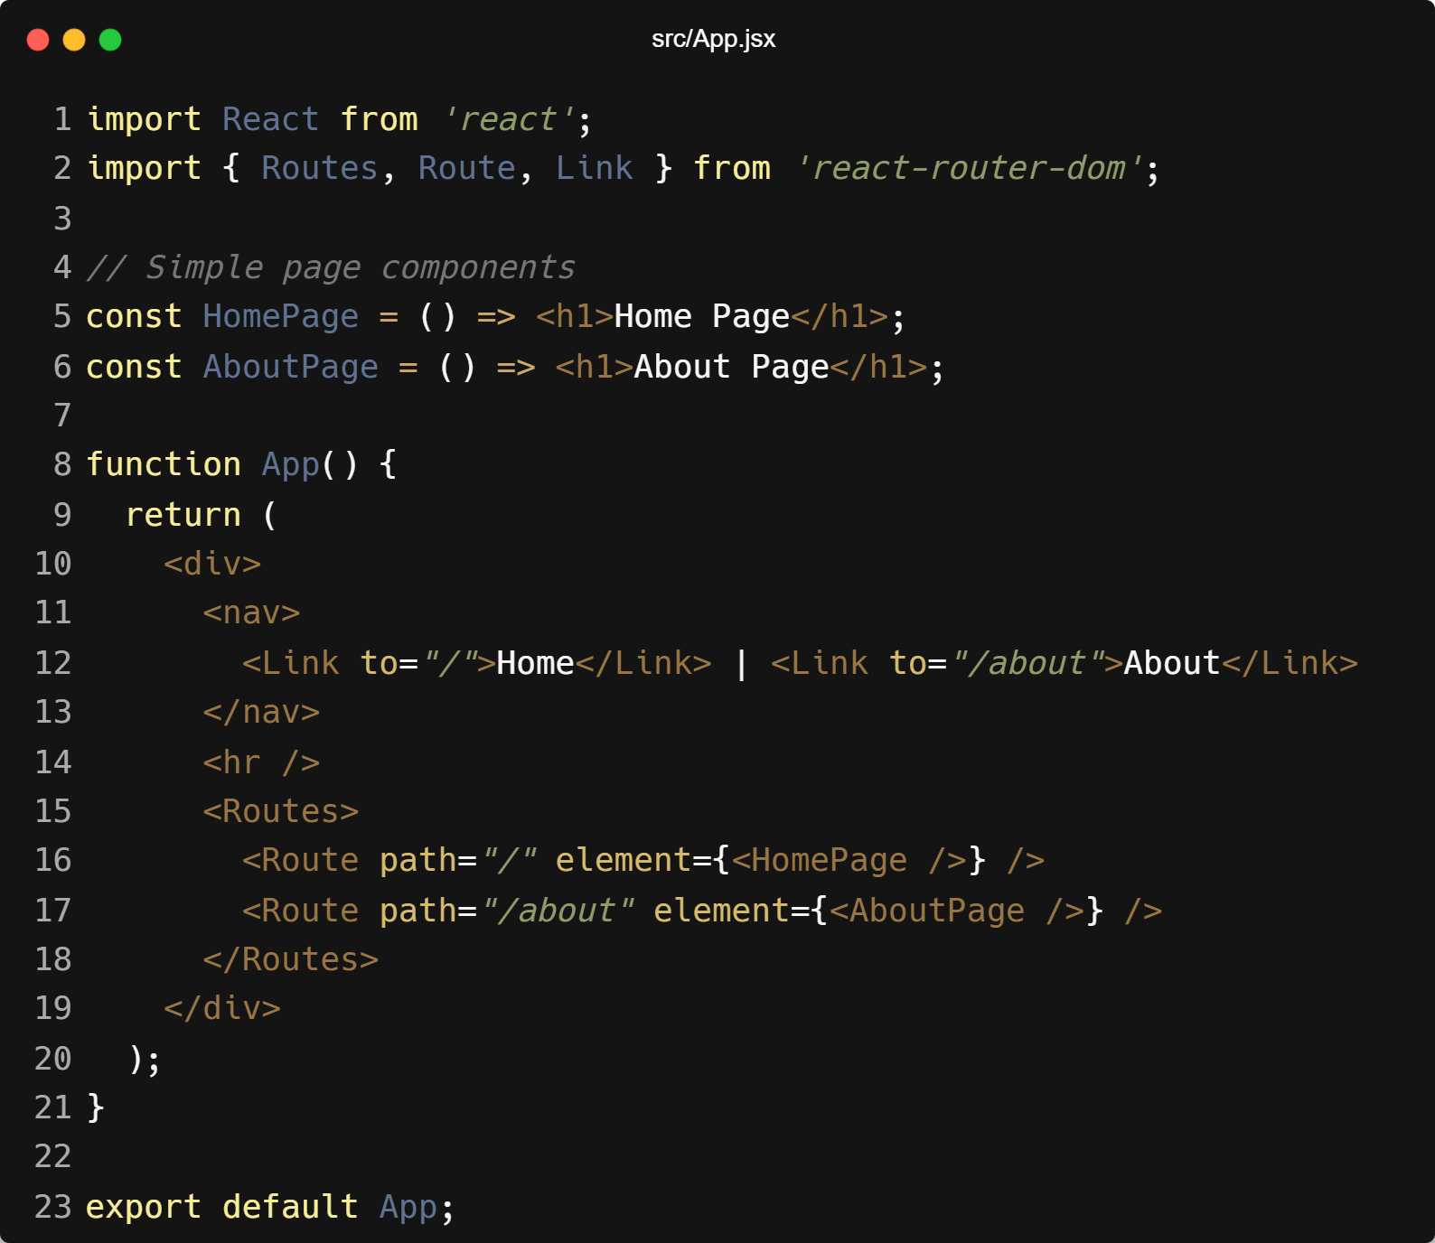
| Coding Questions
Solution :

Slide 19
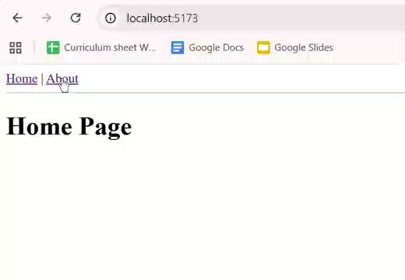
| Coding Questions
Output :

Slide 20
| References
MDN Web Docs : Comprehensive and official documentation for JS. 🔗https://developer.mozilla.org/en-US/docs/Web/JavaScript
W3Schools – JS Tutorial : Beginner-friendly JS tutorials with examples and interactive editors. 🔗 https://www.w3schools.com/js/
react.dev - A comprehensive, tutorial-style website that deeply explores core React concepts, including components, state, effects, and hooks, through interactive examples and in-depth explanations.
🔗https://react.dev/

Slide 21
Thanks
For
Watching
Course - Web Development - II
welcome@krmangalam.edu.in
Sohna Road,Gurugram,Haryana 122103

